Slide 1
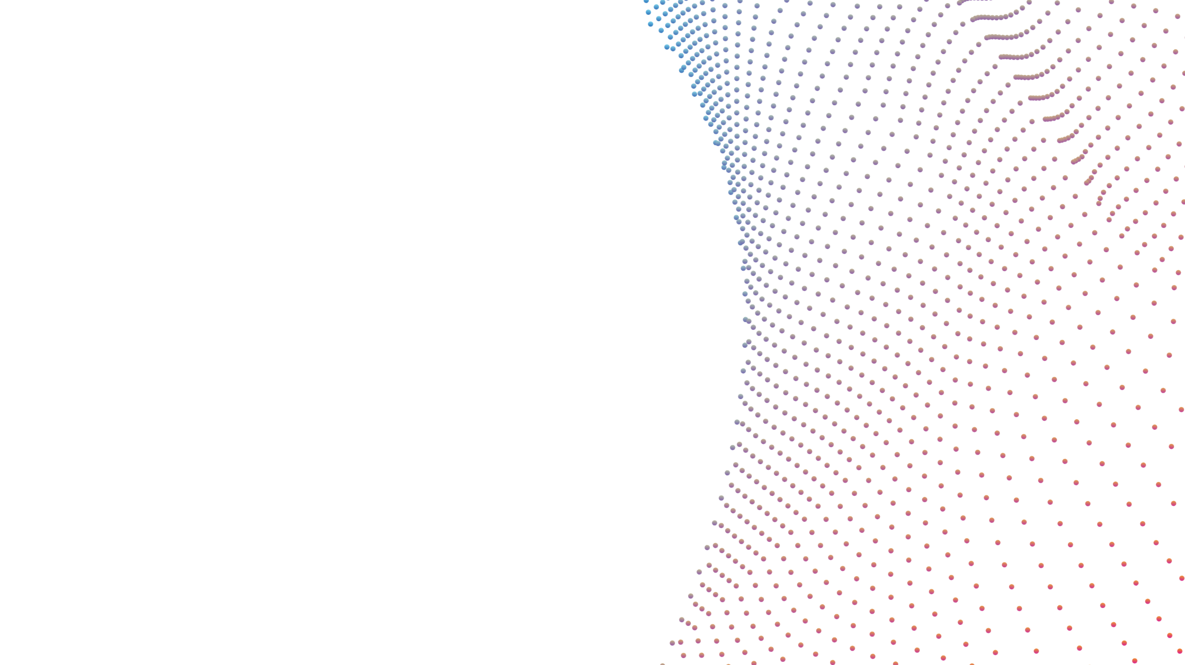
Welcome to Azure Synapse Technical Boot Camp Day 2
Azure Synapse Analytics Technical Boot Camp Day 4

Slide 2
A look into Day 4
Kick-off | 8:00-8:05 | Welcome | Main Call
 | 8:05-8:30 | Challenge Introduction
Challenge | 8:30-9:30 | PoC Challenge | Table Group Call
 | 9:30-9:45 | Break
 | 9:45-11:00 | PoC Challenge
 | 11:00-11:15 | Break
 | 11:15-12:00 | PoC Challenge
 | 12:00-1:00 | Break
 | 1:00-2:00 | PoC Challenge
Wrap Up | 2:00-2:30 | Challenge Debrief | Main Call
 | 2:30-3:00 | Closing
Today we will be learning and collaborating across three spaces:
Main call (this meeting)
Table Group channel within the event Team
CloudLabs Learner Portal & Synapse environment
Presentation/
Whole Group
Lab
Activity/ Discussion/ Group Work
Announcements

Slide 3

Your challenge should you choose to accept it:
Wide World Importers needs your help!
Work as a team and prove to them you have what it takes.
It won’t be easy alone, but as ONE Microsoft, you can do this!
Complete as many of the challenges as you can, but don’t worry about getting them all done.
This Photo by Unknown Author is licensed under CC BY

Slide 4

Not allowed
Scaling SQL Pools up
Working in other SQL Pool schema than wwi_poc
Using other files from the data lake to import sales data other than the ones explicitly mentioned in the description of the challenge
This Photo by Unknown Author is licensed under CC BY

Slide 5
Your Challenge Should You Accept It…
CHALLENGE
Wide World Importers needs your help!
ACTIVITY
240 minutes
Each Other!
Table Group Call & Need Help? Ask Here! channel
Work as a team and prove to them you have what it takes.
It won’t be easy alone, but as ONE Microsoft, you can do this!
Login to your CloudLabs environment and complete as many of the challenges as you can, but don’t worry about getting them all done.
Remember you have access to all the resources you need from the week: Check out the Files tab in the General channel.
Welcome | Challenge Introduction | PoC Challenge | Break | PoC Challenge | Break | PoC Challenge | Break | PoC Challenge | Challenge Debrief | Closing

Slide 6
Your Challenge Should You Accept It…
CHALLENGE
Wide World Importers needs your help!
ACTIVITY
180 minutes
Each Other!
Table Group Call & Need Help? Ask Here! channel
Work as a team and prove to them you have what it takes.
It won’t be easy alone, but as ONE Microsoft, you can do this!
Login to your CloudLabs environment and complete as many of the challenges as you can, but don’t worry about getting them all done.
Remember you have access to all the resources you need from the week: Check out the Files tab in the General channel.
Welcome | Challenge Introduction | PoC Challenge | Break | PoC Challenge | Break | PoC Challenge | Break | PoC Challenge | Challenge Debrief | Closing

Slide 7
Your Challenge Should You Accept It…
CHALLENGE
Wide World Importers needs your help!
ACTIVITY
105 minutes
Each Other!
Table Group Call & Need Help? Ask Here! channel
Work as a team and prove to them you have what it takes.
It won’t be easy alone, but as ONE Microsoft, you can do this!
Login to your CloudLabs environment and complete as many of the challenges as you can, but don’t worry about getting them all done.
Remember you have access to all the resources you need from the week: Check out the Files tab in the General channel.
Welcome | Challenge Introduction | PoC Challenge | Break | PoC Challenge | Break | PoC Challenge | Break | PoC Challenge | Challenge Debrief | Closing

Slide 8
Your Challenge Should You Accept It…
CHALLENGE
Wide World Importers needs your help!
ACTIVITY
60 minutes
Each Other!
Table Group Call & Need Help? Ask Here! channel
Work as a team and prove to them you have what it takes.
It won’t be easy alone, but as ONE Microsoft, you can do this!
Login to your CloudLabs environment and complete as many of the challenges as you can, but don’t worry about getting them all done.
Remember you have access to all the resources you need from the week: Check out the Files tab in the General channel.
Welcome | Challenge Introduction | PoC Challenge | Break | PoC Challenge | Break | PoC Challenge | Break | PoC Challenge | Challenge Debrief | Closing

Slide 9

Mentimeter Poll
Scan QR Code
or Go to www.menti.com and use code
96 23 48 4

Slide 10
A few takeaways
Never trust already existing data or structure
Make sure you run your data processes “pedal to the metal”
Always work on small subsets first
Assume all files are “bad” – “good” is just a nice surprise
Fail fast, change optics even faster
Don’t be shy of moving out of the SQL world
Think outside of the box
Explore first, then understand, then “solve”

Slide 11
A few (more general) takeaways
The days of “I know only SQL” and “I’m a pure DE/DS, I hate SQL” are gone
A PoC is all about the end result – there is no price for “elegance”
A 360-degree view on Synapse is critical to success

Slide 12
Thank You
Thank You slide
Thank you

